Slide 1
Release Early, Revise Often

Slide 2
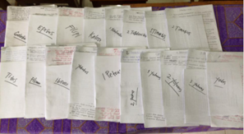
?
When should a translation be shared with the language community?
When the translators have made it
the best they can
at the time

Slide 3
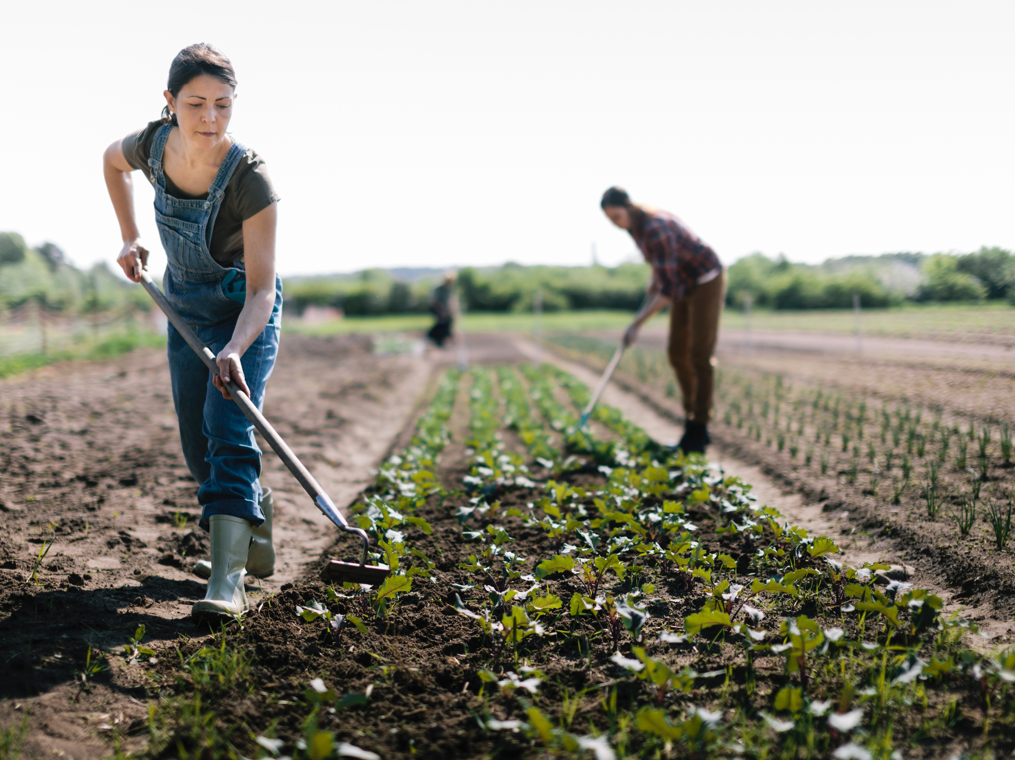
Ecclesiastes 11:2, 4

Slide 4
?
Why might some translators be hesitant?
What are some concerns?

Slide 5
Feedback
Corrections
Improvements
Updates

Slide 6
?
What kinds of changes?
How could the team and Church encourage feedback?

Slide 7

?
What could happen
if the team does not release early?
Language changes

Slide 8


